Slide 1
Adding Equipment to the Application
August 2023

Slide 2
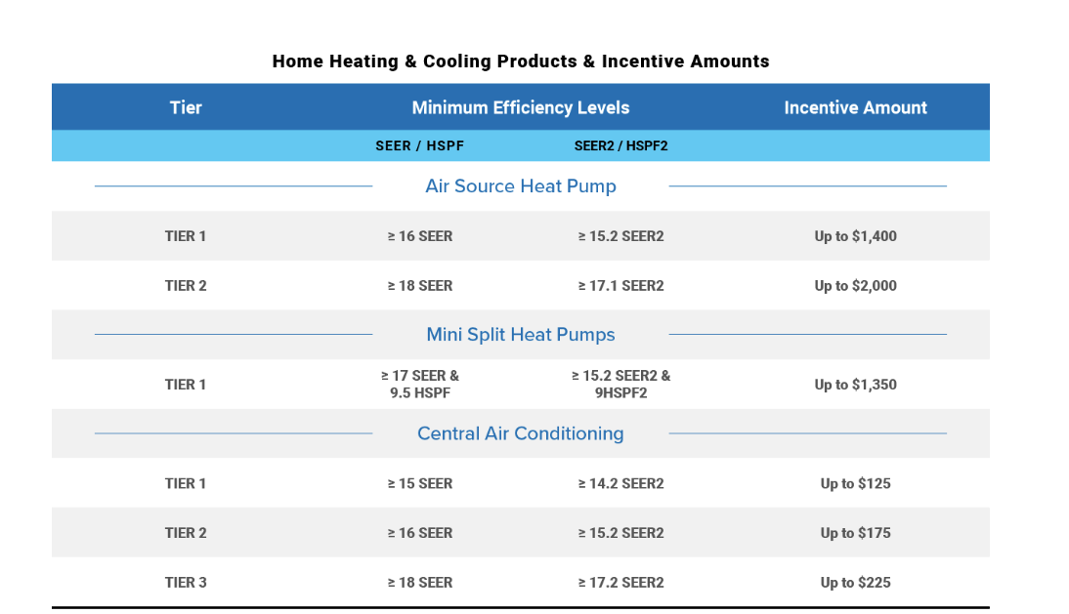
Equipment Eligibility & Incentives
The equipment must be purchased from Daikin
Must have an AHRI certificate and meet the minimum efficiency levels.
The minimum efficiency levels will default to SEER2 requirements if the equipment has both SEER and SEER2 data.

Slide 3

Adding Equipment Video

Slide 4
Reimbursement Process
Reimbursement applications are paid within 5-7 business days of approval via ACH.
Applications are processed in the order in which they are received and typically within 2-3 business days of submission.
Applications status can be viewed within the portal additionally status emails are sent to the email address who set up the account.

Slide 5
Helpful Links and Contact Information
Reimbursement Portal address - https://daikin.distributorprograms.com/
Contact Information
E: Midstreamprograms@egia.org
T: 888-645-3859

